Slide 1
BILLY-BUDDY AGAINST CYBER BULLYING
PIP2001 Capstone Project
Review-1
Batch Number: CST-G16
Roll Number | Student Name
20211CST0092 | Mekala Charan Kumar
20211CST0137 | Krithik S
20211CST0031 | Gandu Sanjay
20211CST0014 | Mohammed Kaif
Under the Supervision of,
Dr. Marimuthu K,
Professor,
School of Computer Science and Engineering,
Presidency University.
Name of the Program: B.TECH
Name of the HoD: Dr. Saira Banu Atham
Name of the Program Project Coordinator: Dr. H M Manjula
Name of the School Project Coordinators: Dr. Abdul Khadar A

Slide 2
Introduction
Cyberbullying has become an increasingly serious issue with the rise of social media platforms, online communication tools, and the internet. According to Smith et al. (2008), cyberbullying refers to aggressive, intentional acts carried out repeatedly via electronic forms of contact, targeting victims who cannot easily defend themselves. It affects children, teenagers, and adults, often leading to severe emotional, psychological, and social consequences (Tokunaga, 2010). This section provides a broad overview of the problem to contextualize the development of solutions like "Billy-Buddy."

Slide 3
Literature Review
Deep-Learning-Based Cyberbullying Detection:The paper reviews deep learning-based cyberbullying detection techniques, analyzing existing methods, datasets, and future research challenges.
Predicting Cyberbullying on Social Media in the Big Data Era:The paper reviews cyberbullying prediction models on social media, focusing on feature selection, machine learning algorithms, and key challenges for future research.
Artifcial Intelligence‑Enabled Cyberbullying‑Free Online SocialNetworks in Smart Cities:The paper proposes an AI-enabled technique (AICBF-ONS) for detecting cyberbullying in online social networks using feature selection and classification models optimized with advanced algorithms.
A Review of Machine Learning Techniques in Cyberbullying Detection:The paper provides a systematic review of machine learning and natural language processing methods for detecting cyberbullying, highlighting key stages, challenges, and future research directions.
Artificial Intelligence-Driven Cyberbullying Detection:The paper reviews deep learning techniques for detecting cyberbullying on online platforms, highlighting current advancements and future research opportunities.

Slide 4
Existing method Drawback
Lack of Anonymity
Delayed Response from Authorities
Limited Emotional Support
Insufficient Awareness and Education
Fragmented Reporting Systems
Lack of Community Support
Underreporting of Cyberbullying

Slide 5
Proposed Method
Chatbot Integration (Billy):
1.Develop an AI-powered chatbot that provides immediate emotional support to victims of cyberbullying.
2.The chatbot will interact with users in a conversational manner, asking relevant questions to gather details about the
bullying incident.
3.It will offer comfort and guide users through the reporting process while maintaining their anonymity.
2. Anonymity and Secure Reporting:
1.Implement a secure and encrypted reporting system to ensure the victim's identity remains confidential when submitting a
report to the cybercrime department.
2.Use authentication and encryption techniques to protect sensitive user data.
3. Community Support Platform:
1.Create an online forum where victims of cyberbullying can connect with others who have faced similar challenges.
2..Facilitate group discussions, Q&A sessions, and peer mentoring to help victims share coping strategies and experiences.
4. Data Collection and Analysis:
1.Use machine learning algorithms to analyze reported cyberbullying cases and identify patterns, trends, and high-risk
areas.
2.The data collected will be anonymized and used to provide insights to law enforcement and policymakers to combat
cyberbullying more effectively.

Slide 6
Proposed Method Cont.
5. Educational Content and Defense Tactics:
1.Provide users with educational materials on identifying cyberbullying, legal rights, and how to handle such
situations.
2.Include interactive tutorials, videos, and guides on safe online practices, how to block/report abusive users,
and ways to protect personal information.
6. Sentiment and Behavior Analysis:
1.Use natural language processing (NLP) to analyze chat interactions and identify the emotional state of the
victim, providing tailored emotional support and resources.
2.Implement behavior tracking to detect recurring patterns that indicate bullying and proactively offer help.
7. Periodic Surveys and Feedback:
1.Implement surveys to gather feedback from users about their experience with the platform, the chatbot, and
the community.
2.Use this feedback to improve the user experience and adapt to evolving needs.
8. Mobile Application Development:
1.Create a mobile app version of the platform to ensure that victims can easily access support and report incidents on-
the-go, increasing the platform's reach and usability.

Slide 7
Objectives
Based on the observations and research gaps identified in the literature survey, the following specific objectives have been formulated:
Use the chatbot “Billy” to offer instant, compassionate support to victims of cyberbullying.
Protect victims identities while enabling them to report cyberbullying incidents to the cybercrime department.
Track and monitor cyberbullying incidents geographically to help law enforcement focus on high-risk areas.
Create a platform where victims can connect, share experiences, and learn coping strategies from others who have faced cyberbullying.
Provide tips, educational materials, and defense tactics to empower individuals to protect themselves from online harassment.
Collect data on cyberbullying incidents to identify trends and help policymakers address the issue proactively.

Slide 8
Methodology
Methodology
Problem Identification : Research and understand the impact of cyberbullying, particularly among teenagers. Identify the shortcomings of existing cyberbullying reporting and support mechanisms.
Chatbot Development (Billy):Design and develop a user-friendly, AI-powered chatbot (“Billy”) that offers real-time emotional support. Integrate Natural Language Processing (NLP) for understanding victim emotions and guiding conversations.
Anonymous Reporting System:Build a secure, encrypted platform for victims to report cyberbullying cases anonymously. Ensure automatic and seamless communication between the reporting platform and cybercrime authorities.
Community Support Platform:Develop an online community forum where victims can share their experiences and offer support to others. Include Q&A sessions, personal stories, and tips on overcoming cyberbullying challenges.
Educational Resources:Curate educational content on cyberbullying, including defense tactics, online safety, and ways to identify and respond to cyberbullying. Provide interactive guides and videos for both teenagers and parents.
Testing and User Feedback:Perform extensive user testing to ensure the chatbot and platform are user-friendly and effective. Collect feedback from victims and law enforcement to refine and improve the system.
Data Analysis and Improvement:Use machine learning and analytics to analyze trends from reported data and improve the chatbot's responses.Continuously update the educational content based on user needs and evolving cyberbullying tactics.

Slide 9
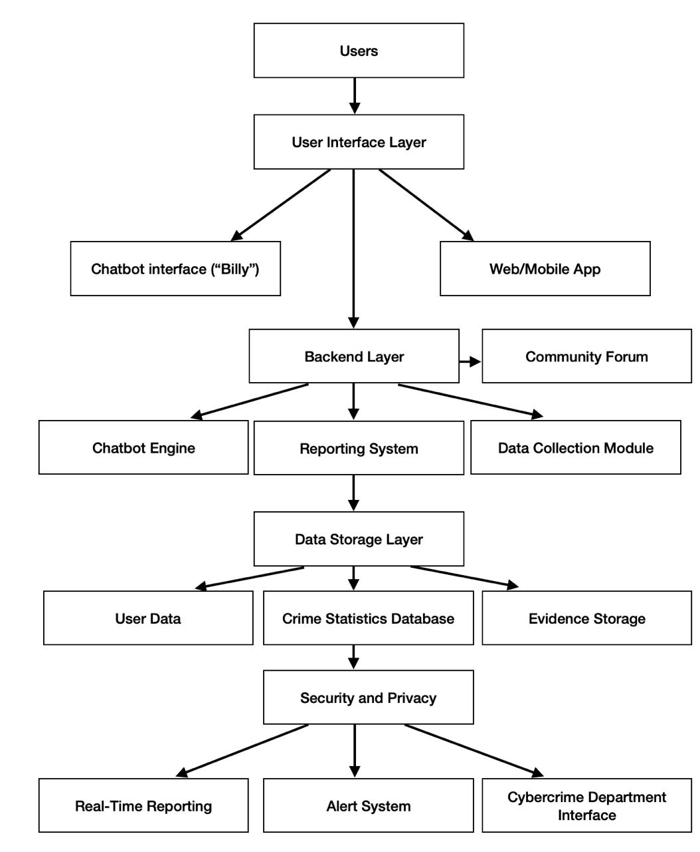
Architecture

Slide 10
Software components
Frontend Software Requirements:
1.VS Code(Visual Studio Code):A highly popular code editor that supports JavaScript, Node.js, and React development.
2. React (via Create React App), Axios, React Router DOM
3. Chatbot: Dialogflow Web Messenger
Backend Software Requirements:
1. Node.js
2 . Express.js (to create the server)
3. Mongoose (to interact with MongoDB)
4. MongoDB (for storing feedback)
5. CORS and Body-Parser (for request handling)
Database
1. MongoDB (local or cloud-based)

Slide 11
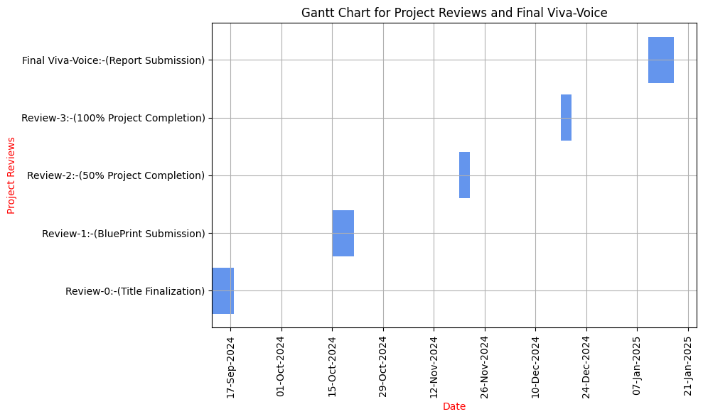
Timeline of the Project (Gantt Chart)

Slide 12
Expected Outcomes
Increased Reporting of Cyberbullying Incidents: Victims will feel more comfortable reporting cyberbullying through the anonymous chatbot, leading to a higher number of cases being reported.
Timely Intervention: The real-time reporting system will enable faster responses from law enforcement, helping to address cyberbullying incidents more promptly.
Improved Victim Support: Victims will receive instant emotional support through the chatbot, reducing feelings of isolation, fear, and frustration.
Anonymity Assurance: Victims’ identities will remain protected throughout the reporting process, encouraging more individuals to come forward without fear of retaliation.
Increased Awareness of Cyberbullying: Educational resources and defense tactics on the platform will increase awareness about cyberbullying, its effects, and ways to combat it.
Formation of a Supportive Community: A virtual community of individuals who have experienced cyberbullying will provide emotional and practical support, helping new victims recover and learn coping strategies.
Data-Driven Law Enforcement: Cyber-crime statistics collected through the platform will help authorities focus on high-risk areas, enabling better resource allocation and targeted actions.
Reduction in Cyberbullying: With increased awareness, support, and law enforcement focus, there is potential for a gradual reduction in the overall number of cyberbullying cases.
Empowerment of Youth and Users: By providing access to self-help tools, defense tactics, and community support, the project will empower individuals to take proactive steps to protect themselves from cyberbullying.
Improved Mental Health Outcomes: Victims who receive timely support and feel part of a community are more likely to experience improved mental health, reducing the long-term psychological impact of cyberbullying.

Slide 13
Conclusion
"BILLY-BUDDY AGAINST CYBER BULLYING" is designed to address the rising issue of cyberbullying by providing immediate emotional support, ensuring victim anonymity, and reporting incidents to the cybercrime department. The innovative chatbot "Billy" empowers victims by offering a safe space to share their experiences, collect evidence, and connect with others who have faced similar challenges. By tracking cyber-crime trends and focusing on high-risk areas, this project contributes to a more proactive approach in tackling cyberbullying. Additionally, the platform’s educational resources and support community aim to equip individuals with tools to protect themselves and promote a culture of resilience. Ultimately, "Billy" serves as both a protective and empowering resource for victims of online harassment.

Slide 14
Github Link
Github Link:
https://github.com/krithik202/Billy-Buddy-against-Cyber-Bullying

Slide 15
References (IEEE Paper format)
The role of perceived severity publicity anonymity type of cyberbullying and victim response.Retirved from https://www.sciencedirect.com/journal/computers-in-human-behavior
An investigation of the effectiveness and determinants of seeking support among adolescent victims of cyberbullying.Retrived from https://doi.org/10.1016/j.soscij.2018.09.011
“A Study of Cyberbullying Detection U sing Machine Learning Technique", 2020 Fourth International Conference on Computing Methodologies and Communi-cation (ICCMC),Retreived from https://ieeexplore.ieee.org/document/9076550
"Offensive text detection using temporal convolutional networks", Int. J. Adv. Sci. Technol, Retreived from https://www.researchgate.offensive text classification
"Cyberbullying detection solutions based on deep learning architectures", Multimedia Systems, Retrieved from https://link.springer.com/article/10.1007/s00530-020-00701-5
"Towards Automatic Detection of Inappropriate Content in Multi-dialectic Arabic Text", Advances in Computational Collective Intelligence. ICCCI 2022. Communications in Computer and Information Science(CCIS), Retrived from https://link.springer.com/chapter/10.1007/978-3-031-16210-7_7
"Multimodal cyberbullying detection using capsule network with dynamic routing and deep convolutional neural network", Multimedia Systems, Retreived from https://link.springer.com/article/10.1007/s00530-020-00747-5

Slide 16
Project work mapping with SDG
Our Project aligns with several key SDG’s are:
By reducing the emotional toll of cyberbullying (e.g., depression, anxiety), the project promotes mental health support for teenagers and vulnerable individuals.(SDG 3)
Educating teenagers on the effects of cyberbullying and how to defend themselves fosters a safer online environment and helps build responsible digital citizens.(SDG 4)
It encourages gender equality by promoting safe online spaces where everyone can participate without fear of harassment.(SDG 5)
The platform ensures that victims of all backgrounds can report cyberbullying anonymously and receive help, thereby reducing inequalities in access to justice and support.(SDG 10)
It promotes peace by reducing online harassment and fostering safer digital communities, contributing to inclusive societies.(SDG 16)

Slide 17
Thank You

